Slide 1
BLAST’d things: search and alignment
Jesse Zaneveld

Slide 2
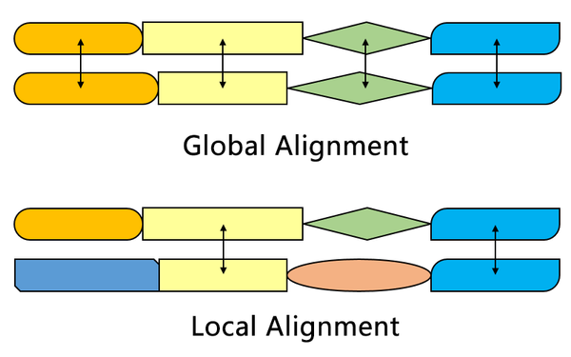
Source: https://en.wikipedia.org/wiki/Smith%E2%80%93Waterman_algorithm

Slide 3
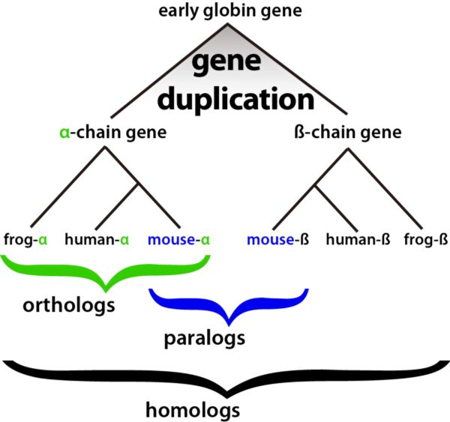
Source: https://en.wikipedia.org/wiki/Smith%E2%80%93Waterman_algorithm

Slide 4
BLAST: Basic Local Alignment Search Tool
Goal: Search for a local alignment between a query sequence and one or more sequences in a sequence database
Uses:
a. Identify sets of putatively homologous sequences based on
sequence similarity
b. Identify putative function of an unstudied gene
c. Identify which organism an unstudied gene came from
(but this is error-prone)
d. find regions of similarity in known homologs
e. Quantify identify sequence similarity

Slide 5
BLAST: Basic Local Alignment Search Tool
Online version: https://blast.ncbi.nlm.nih.gov/Blast.cgi

Slide 6
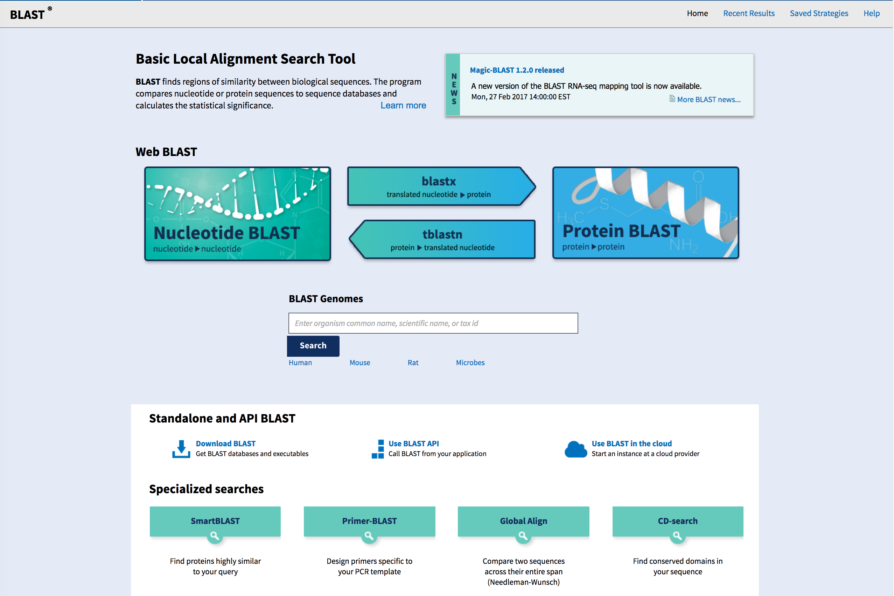
Online version: https://blast.ncbi.nlm.nih.gov/Blast.cgi

Slide 7
Online version: https://blast.ncbi.nlm.nih.gov/Blast.cgi

Slide 8
Exercise: Duck vs. Yeast
Structure of Duck
- crystallin
Saccharomyces cerevisiae (a yeast)

Slide 9
Make a BLAST database from yeast translated genes (i.e. predicted protein sequences):
makeblastdb –in orf_trans.fasta -input_type fasta -dbtype prot
(You can find the yeast genome yourself here:
http://downloads.yeastgenome.org/sequence/S288C_reference/orf_protein/)

Slide 10
Search the database for the duck lens crystalin delta
blastp -query duck_delta_crystallin.fasta -subject orf_trans.fasta -evalue 1e-4 -out duck_vs_yeast.txt -outfmt 6

Slide 11
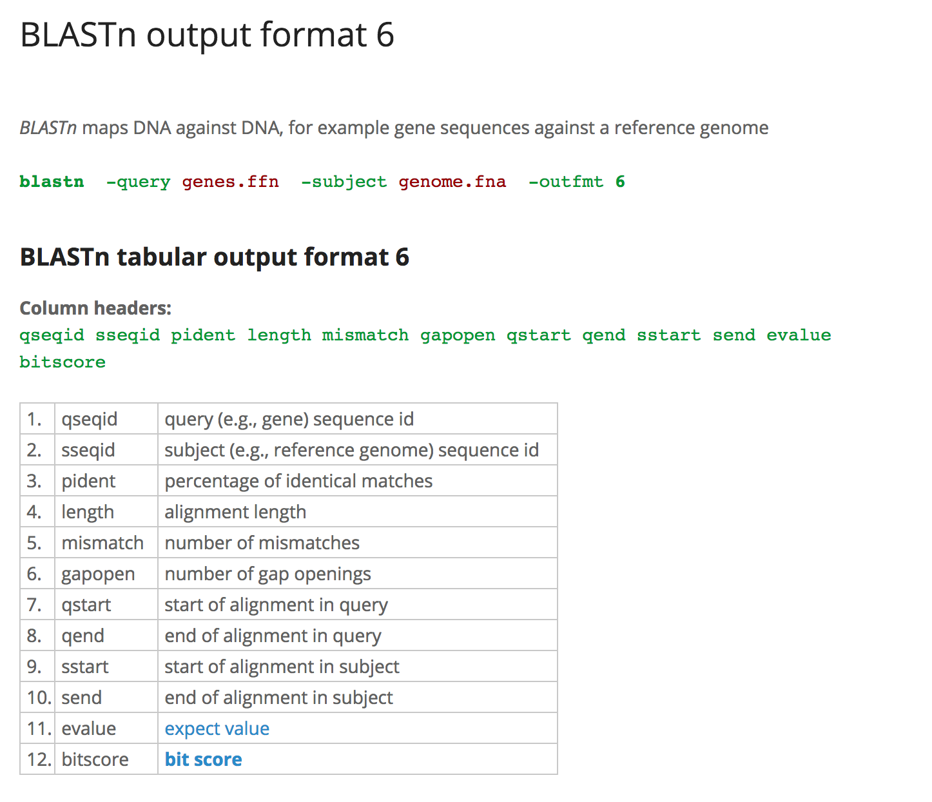
BLAST: Basic Local Alignment Search Tool
Source: http://www.metagenomics.wiki/tools/blast/blastn-output-format-6

Slide 12
Exercise: What is going on?
Structure of Duck
- crystallin
Saccharomyces cerevisiae (a yeast)

Slide 13
Global Alignment: Needleman-Wunsch
Goal: Find an optimal global alignment of two sequences, given a scoring scheme.
Example:
Align two nucleotide sequences:
GCATGCU
GATTACA

Slide 14
Global Alignment: Needleman-Wunsch
Overview:
1. Build a table showing possible alignments
2. Decide on a scoring scheme
3. Fill in the table with scores
4. Trace back through the table to find optimal alignment(s)

Slide 15
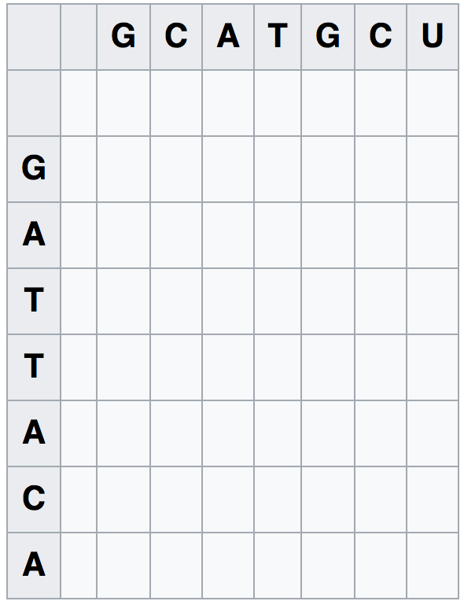
Global Alignment: Needleman-Wunsch
1. Build a Table:
Sequence 1
Sequence 2
Diagonal cells = no gaps (indels)
Vertical line =all gaps
Source: https://en.wikipedia.org/wiki/Needleman%E2%80%93Wunsch_algorithm

Slide 16
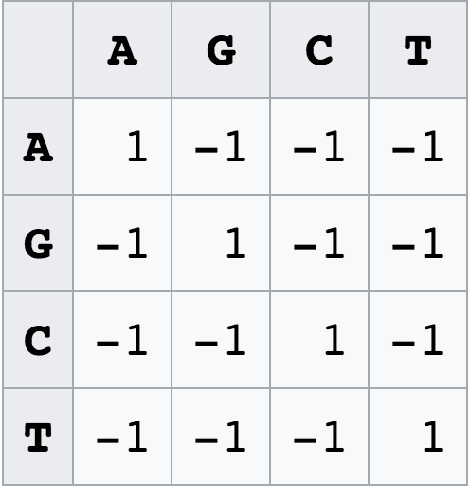
Global Alignment: Needleman-Wunsch
1. Pick a scoring scheme:
A simple scoring scheme: all matches give 1 point,
all mismatches -1 point.
We also need to pick a gap penalty
Source: https://en.wikipedia.org/wiki/Needleman%E2%80%93Wunsch_algorithm

Slide 17
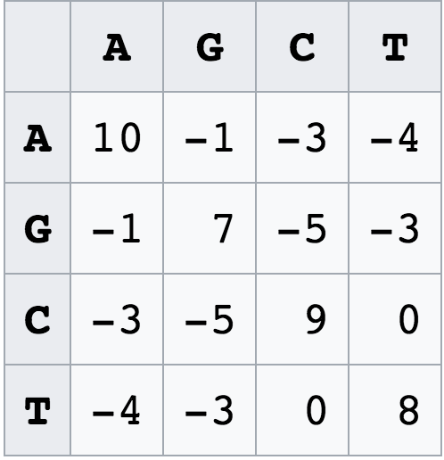
Global Alignment: Needleman-Wunsch
2. Pick a scoring scheme:
A simple scoring scheme: all matches give 1 point,
all mismatches -1 point.
We also need to pick a gap penalty. A simple one is -1
for any indel
A more complex scoring scheme (this one is hypothetical)
These are used to capture more biologically frequent
changes
Source: https://en.wikipedia.org/wiki/Needleman%E2%80%93Wunsch_algorithm

Slide 18
Global Alignment: Needleman-Wunsch
3. Fill in scores
Put a 0 here
(before start of sequences)
Best score from left, above,
or above-left
+
match/mismatch
score if moving diagonally
OR
Gap penalty if moving up
or down
Source: https://en.wikipedia.org/wiki/Needleman%E2%80%93Wunsch_algorithm

Slide 19
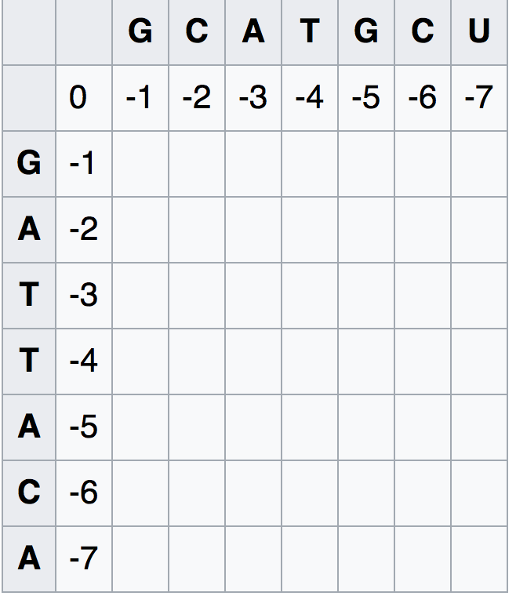
Global Alignment: Needleman-Wunsch
3. Fill in scores
Best score from left, above,
or above-left
+
match/mismatch
score if moving diagonally
OR
Gap penalty if moving up
or down
Source: https://en.wikipedia.org/wiki/Needleman%E2%80%93Wunsch_algorithm

Slide 20
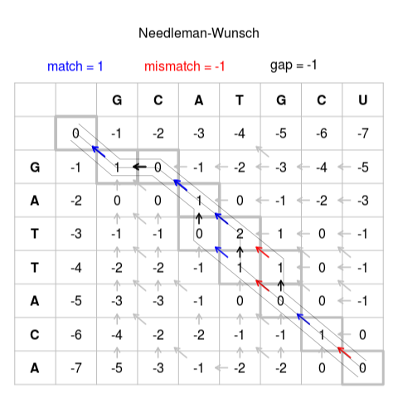
Global Alignment: Needleman-Wunsch
3. Fill in scores
Best score from left, above,
or above-left
+
match/mismatch
score if moving diagonally
OR
Gap penalty if moving up
or down
Source: https://en.wikipedia.org/wiki/Needleman%E2%80%93Wunsch_algorithm

Slide 21
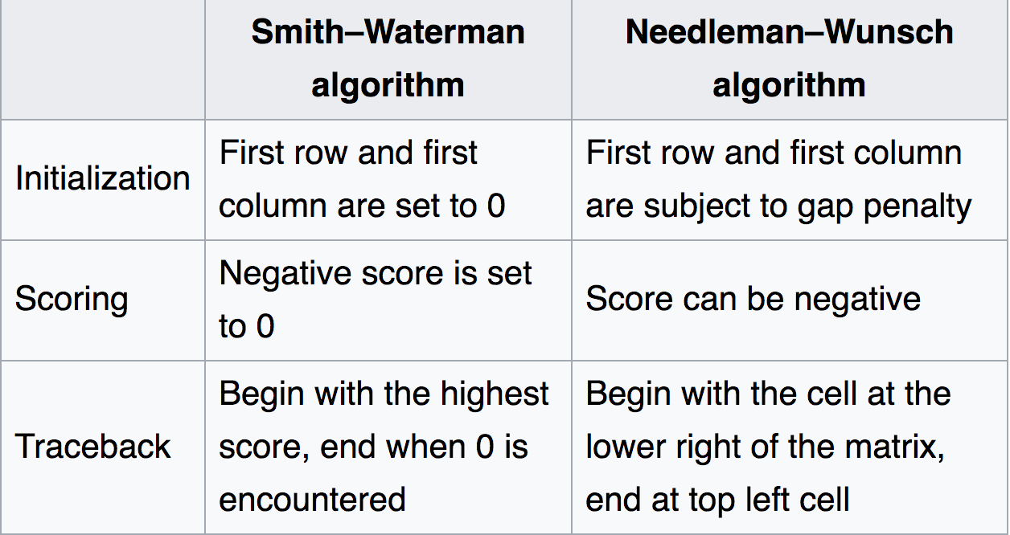
Local Alignment: Smith-Waterman
Like Needleman-Wunsch, but...

Slide 22
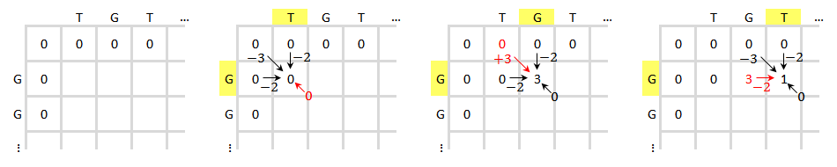
Local Alignment: Smith-Waterman
Like Needleman-Wunsch, but...

Slide 23
Work-a-day python
[Live]
dict review
list comprehensions
defaultdicts
itertools

Slide 24
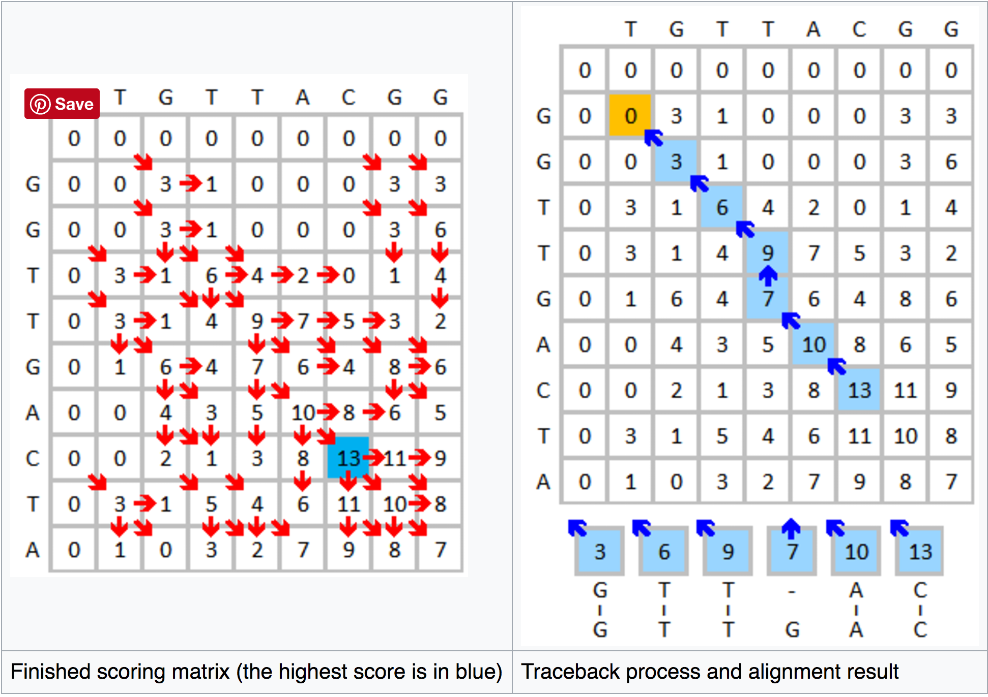
Local Alignment: Smith-Waterman

Slide 25
BLAST: Overview
Seeding: Find ‘words’ (short sequences) in common. Controlled by word-size parameter W.
Filtering: Only compare sequences with enough words in common. Test alignment only in regions with enough words in common.

Slide 26
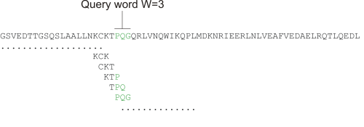
Source: http://resources.qiagenbioinformatics.com/manuals/clcmainworkbench/current/index.php?manual=Seeding.html

Slide 27
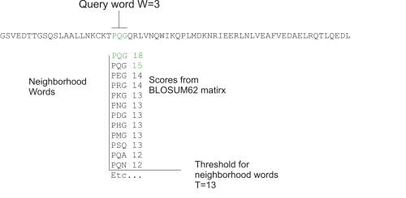
Source: http://resources.qiagenbioinformatics.com/manuals/clcmainworkbench/current/index.php?manual=Seeding.html

Slide 28
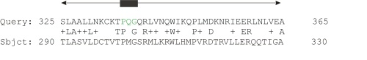
Source: http://resources.qiagenbioinformatics.com/manuals/clcmainworkbench/current/index.php?manual=Seeding.html

Slide 29
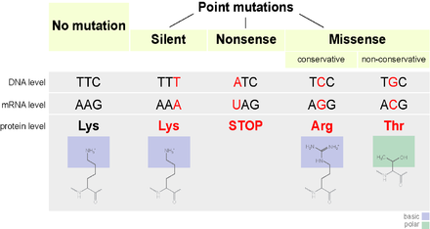
Because the value {\displaystyle n} n in the PAMn matrix represents the number of mutations per 100 amino acids, which can be likened to a percentage of mutations, the term percentage accepted mutation is sometimes used.
Source: https://en.wikipedia.org/wiki/Point_accepted_mutation

Slide 30
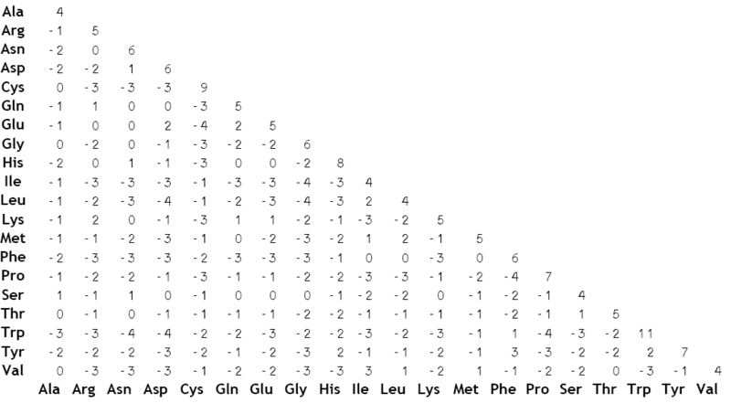
Scoring matrices: BLOSUM
The BLOSUM
scoring matrix – an emprical
scoring matrix for amino acid
alignment.
Source: https://en.wikipedia.org/wiki/BLOSUM

Slide 31
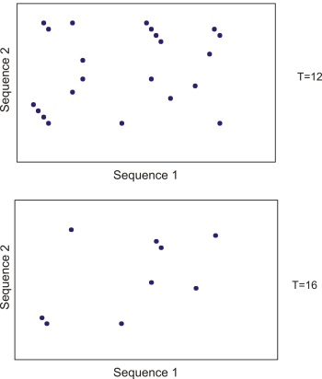
Limiting word size restricts
the number of possible sequence
pairs that have to be compared
Source: http://resources.qiagenbioinformatics.com/manuals/clcmainworkbench/current/index.php?manual=Seeding.html

